Slide 1


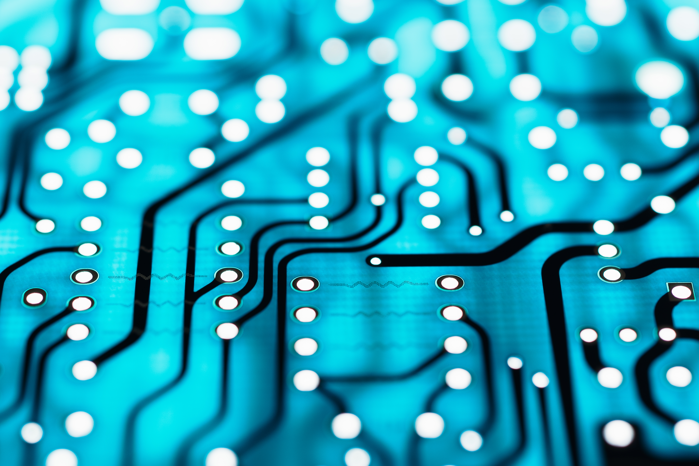
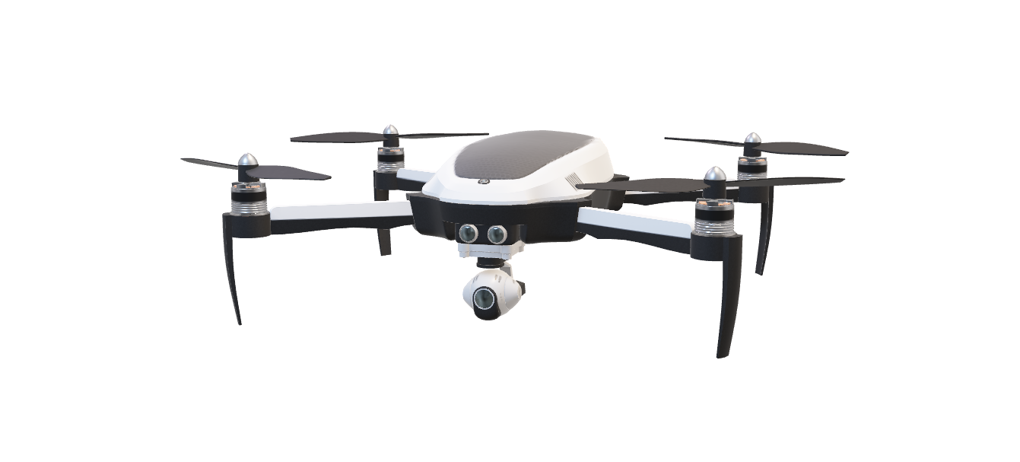
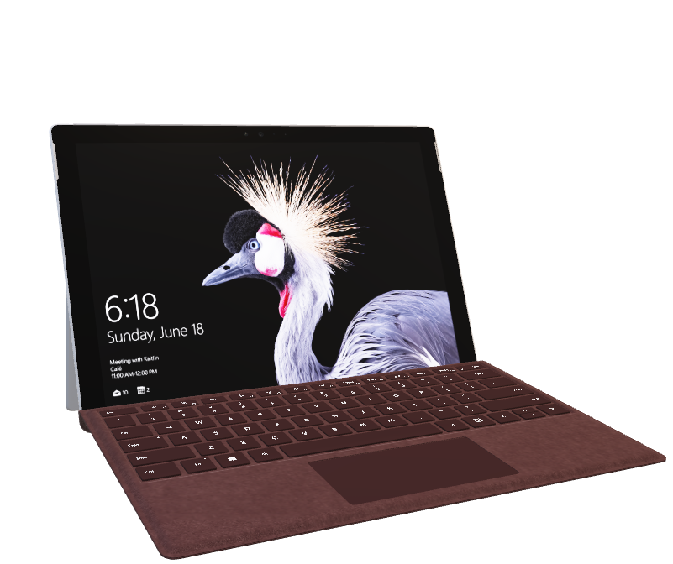
Emerging Trends
Haley Bishop

Slide 2
Background History of Technology Trends
Its crazy to think how the internet has shaped the world we know today? According to HubSpot, “…there are more than 1.58 billion websites and approximately 5 billion daily users on the internet.” (Kundariya-Hubspot)
With that security is growing as well. Some things include fingerprint identification, ways to protect passwords, and many others too!

Slide 3

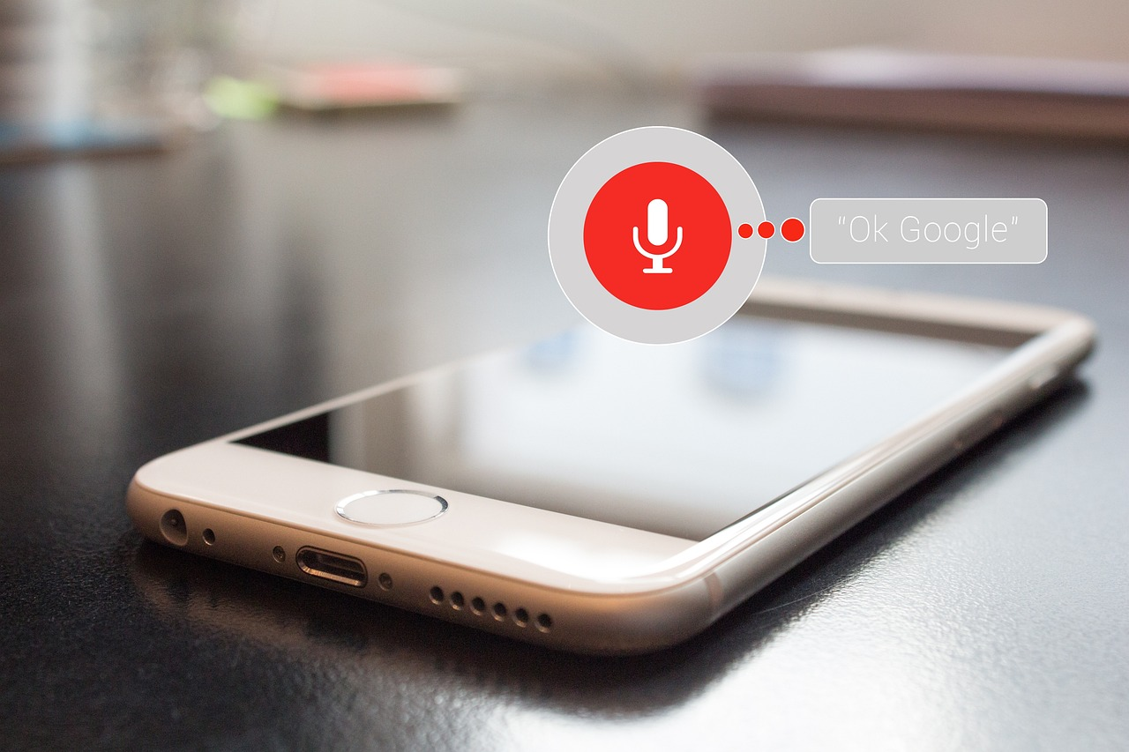
1) Optimized Voice Search/voice Assitants
When it comes to voice searching it can helpful. I believe that it helps because some people cannot text and drive at the same.
Pros: can help when we can’t use the phone because we occupied with something. For example, it can help people with disabilities. (Pribanic-TechTunnel)
Cons: Sometimes can causes issue. You could accidently say the wrong thing and mess with another app or something online you own. Also you can get distracted from actually what your doing and potentially mess it up. Its kinda has a limit it seems like to some things. Also if it has a delay it can cause issues of how you get things(Pribanic-TechTunnel)
A pro and con I feel like is spelling because I actually can relate to this. It is helpful because it might be able to help us spell something correctly we don’t know how to, however it might hear us incorrectly and not search or write it correctly.
First introduced by Google in 2011and grew more popular in 2019 (Kundariya-Hubspot)

Slide 4
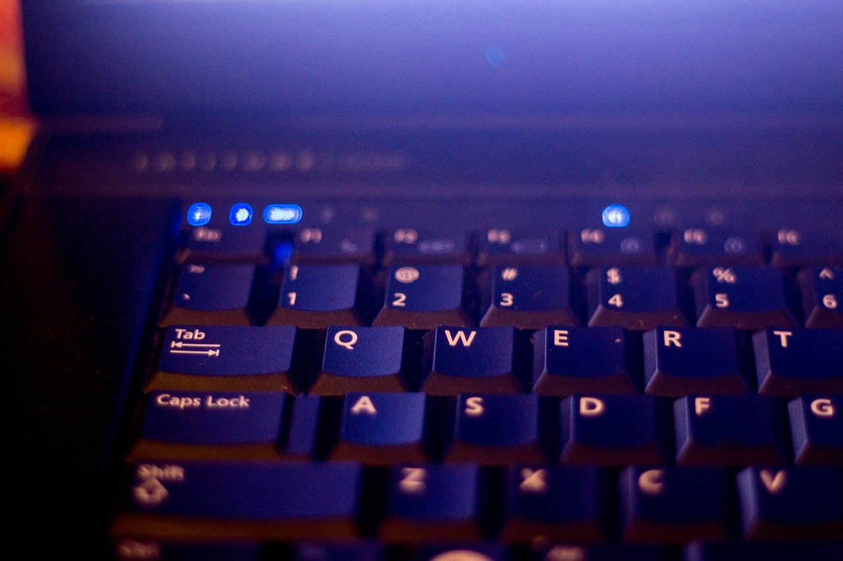
2) Dark Mode Standardization
My opinion on this is can be helpful. It gives users the opportunity to use it in many different ways
Pros: Some people are sensitive to light. It also can be helpful in terms of design, cuz it can make things pop (TBH Creative)
Cons: It can not always be the best for the eye, like according to Forbes, it could cause even maybe a eye strain.(Lunn-Forbes) It also might make hard to read text that is lighter in a bright lit room or environment. (Lunn-Forbes)
Websites sometimes have a toggle mode for light/dark mode. Some are automatically already dark because of the web design.
One thing I do know is that it can/can’t help with sleep with having a screen darker. Bright lights can interfere with how it affects you trying to fall asleep where others make struggle to fall asleep for looking at the screen to long.

Slide 5
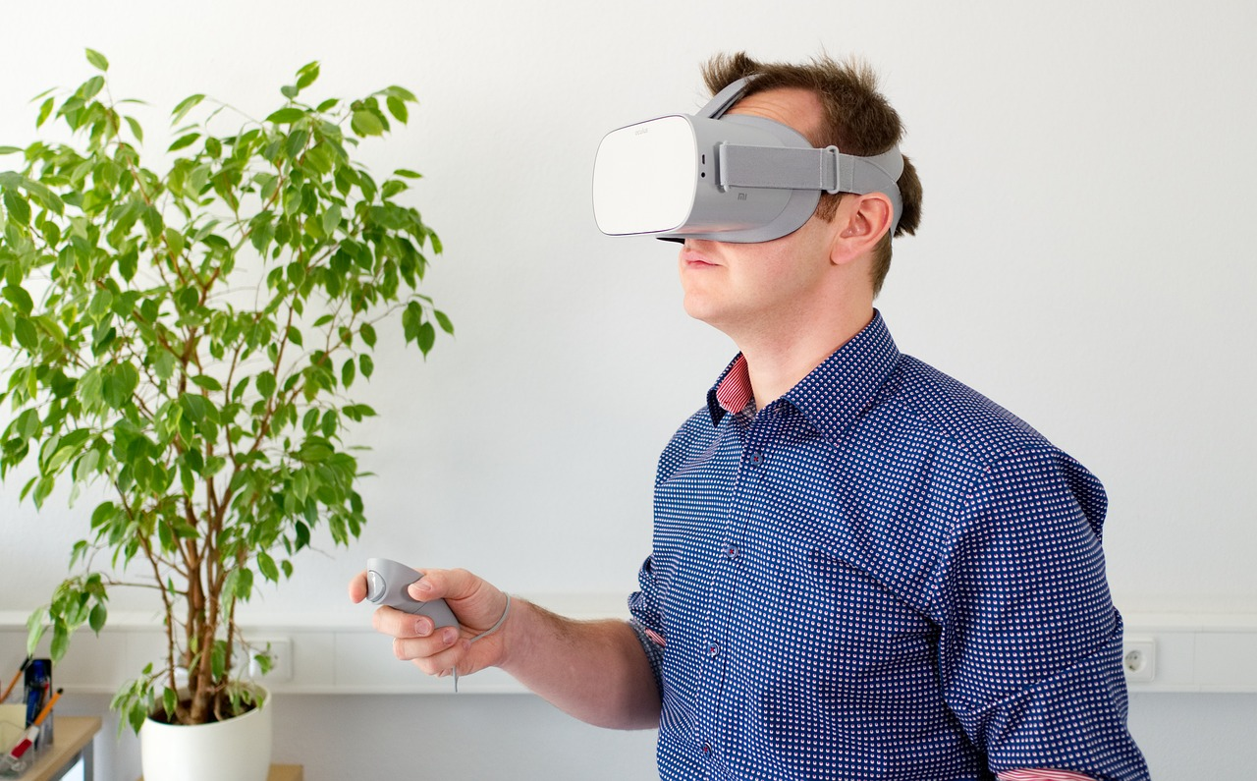
3) Augmented reality (Web Ar)
Augmented reality why is it important? I believe it helps us dive deep into seeing the world on a new perspective.
VR Headsets and website like steam to interactive VR options within apps or stores such as Amazon or Instagram.
Pros: can reduce time for service (Yevheniia-:codica) For example, Snapchat has businesses that promote filters like IKEA or Best Buy, so people can try on options for things and convince people who are consumers to buy things.
Cons: its more newer technology in general. Sometimes it might struggle load at a better speed due your internet bandwidth. (Rock Paper Reality)
  Source: https://rockpaperreality.com/insights/web-ar/web-ar-challenges/
Examples:
  https://thespaces.com/ikea-place-app/
  https://www.amazon.com/adlp/arview

Slide 6
Sources:
https://blog.hubspot.com/website/web-development-trendsF
https://www.codica.com/blog/top-web-development-trends/#:~:text=The%20following%20web%20trends%20will,search%2C%20Blockchain%2C%20and%20IoT.
https://www.techfunnel.com/information-technology/7-pros-and-cons-of-using-speech-recognition-in-business/
https://blog.tbhcreative.com/dark-mode-design-14-examples-of-black/
https://www.forbes.com/uk/advisor/mobile-phones/what-is-dark-mode-and-should-you-be-using-it/
https://www.forbes.com/sites/forbestechcouncil/2023/01/09/what-the-history-of-technology-trends-started-by-hyperscalers-means-for-security/?sh=71b3c4d7767d
https://www.vrowl.io/the-advantages-disadvantages-and-costs-of-webar/
https://www.vrowl.io/everything-you-need-to-know-about-webar-the-future-of-augmented-reality/

